Slide 1
Chapter 06
Classes and Objects
Learn To Program Java

Slide 2
Procedural Abstraction
Method is a collection of data types and statements.
Use of the method does not require the user to know how the method has been written.
User has to know how the method is called to produce the desired outcome.
Every time the method is called accordingly it will produce the expected result.
Learn To Program Java

Slide 3
Data Abstraction
An alternate approach to Procedure Abstraction is Data Abstraction.
Develop a program for inserting and removing items from a data storage structure.
  Items can only be inserted into the data store provided the data store is not full.
  No item can be removed if the data store is empty.
Item 11
Item 10
Item 9
Item 8
Item 7
Item 6
Item 5
Item 4
Item 3
Item 2
Item 1
Data store empty
Remove item 10
Remove item 9
Remove item 8
Remove item 7
Remove item 6
Remove item 5
Remove item 4
Remove item 3
Remove item 2
Remove item 1
Add item 1
Add item 2
Add item 3
Add item 4
Add item 5
Add item 6
Add item 7
Add item 8
Add item 9
Add item 10
Data store full
Learn To Program Java

Slide 4
Data Abstraction (cont)
Use an array of integer to represent data store.
An integer to indicate the next available index to store item in the array.
A method to check is the array empty.
A method to check is the array full.
A method to push/insert integer into the array, if array is not full.
A method to pop/remove integer out of the array, if array is not empty.
class Chap6InsertRemove {
static int content[] = new int[10];
static int index = 0;
static boolean empty() {
return (index == 0) ? true:false;
}
static boolean full() {
return (index > 9) ? true:false;
}
static void push(int i) {
content[index++] = i;
}
static int pop() {
return content[--index];
}
public static void main(
String [] argv) {
……………
}
}
Full program listing
Learn To Program Java

Slide 5
Stack as a Data Abstraction
The previous contains data and operations that are typical of a data structure commonly used in Computer Science.
A stack holds and manipulates its stored items using a first-in-last-out policy.
Items are pushed (or added) into a stack if the stack is not full
The last item pushed into a stack shall be the first item to be removed (or popped).
The pop operation is only successful if there is at least an item in the stack.
Learn To Program Java

Slide 6
Stack as a Data Abstraction (cont)
Modify the previous code by combining related data types and operations that define the concept of Stack together and define them in a separate class.
The definition of Stack is represented by the class Stack while the other class is the user class.
Full program listing: class Stack, user class
In order for the user class to be able to call the stack, it has to know what methods are available and how the methods can be called to operate on the stack.
This concept of grouping data with methods and hiding operational details from users is known as Data Abstraction.
Learn To Program Java

Slide 7
Object-Oriented Programming
The concept of Data Abstraction has been extended over the years into what is now commonly known as Object-Oriented Programming.
Tables, chairs, buses, trees, and even mobile-phones are all examples of real-world objects. Every object in the real world can be modeled as a programming object in Java.
Even abstract things like schedules or diary entries can be modeled as objects.
Learn To Program Java

Slide 8
Object-Oriented
Encapsulation
Inheritance
Polymorphism
Learn To Program Java

Slide 9





Objects and Classes
Classes reflect concepts, objects reflect instances that embody those concepts
object
class
girl
Jodie
Daria
Jane
Brittany
Learn To Program Java

Slide 10
Objects and Classes cont’d
A class captures the common properties of the objects instantiated from it
A class characterizes the common behavior of all the objects that are its instances

Slide 11
Objects and Classes cont’d
Class BankAccount
Balance
InterestYTD
Owner
Account_number
Operations
MakeDesposit
Transfer
WithDraw
GetBalance
Balance 500
InterestYTD
Owner
Account_number
Balance 10,000
InterestYTD
Owner
Account_number

Slide 12
Objects as instances of Classes
The world conceptually consists of objects
Many objects can be said to be of the same type or class
  My bank account, your bank account, Bill Gates’ bank account …
We call the object type a class

Slide 13
Instantiation
An Object is instantiated from a Class
BankAccount myAccount;
myAccount = new BankAccount（）;

Slide 14
Objects and Classes
Class
  Visible in source code
  The code is not duplicated
Object
  Own copy of data
  Active in running program
  Occupies memory
  Has the set of operations given in the class

Slide 15
Classification
Animal
Mammal
Reptile
Rodent
Primate
Cats
Mouse
Squirel
Rabbit

Slide 16

Classification
Enjoy a variety of personal banking options from First American. The following outlines a number of First American products. If you have any questions, please visit any First American Branch or contact us.
Checking
  Bank a lot without spending a lot: ValueFirst® Checking.
  Few checks and prefer PC Banking or ATMs: Select Access.
  Earn interest on checking dollars: First Interest Checking
  You are 55 years or better: 55 & Better Silver
  Premium checking features with higher interest rates than a personal checking account: First American Platinum Checking
  Write less than 10 checks per month, or bank through an ATM: Budget Checking.
  Younger than 24 years old and in school: Student Checking
  Less than 20 transactions per month (excluding ATM, POS, and CheckCard): First Account
  Make the most out of every dollar: Tailored Money Sweep

Slide 17
Classification
Account
Checking Account
Savings Account
Value First
Select Access
First Interest

Slide 18
Inheritance
A class which is a subtype of a more general class is said to be inherited from it.
The sub-class inherits the base class’ data members and member functions

Slide 19
Inheritance cont’d
A sub-class has all data members of its base-class plus its own
A sub-class has all member functions of its base class (with changes) plus its own
Inheritance is meant to implement sub-typing (don’t abuse it)

Slide 20
Abstraction
Management of complexity
Hierarchical classification:
  is-a relationship: inheritance
  has-a relationship: containment

Slide 21
Polymorphism
One interface
Multiple implementations
Inheritance
Method overloading

Slide 22
What is a good class ?
A class abstracts objects
A class should be non-trivial in the context of the program (has data structures and operations different from other classes)

Slide 23
What is Object Oriented Programming?
Object-oriented programming is a method of implementation in which programs are organized as cooperative collections of objects, each of which represents an instance of some class, and whose classes are all members of one or more hierarchy of classes united via inheritance relationships

Slide 24
Modeling a Bus using the Object-Oriented Programming
We need to consider what aspects of a bus are of interest in the solution.
Let us begin to model the bus by considering two properties: colour and number of passengers.
class Bus {
String colour;
int numPassengers = 0;
}
The way objects are defined in Java is to first define a class.
The variables colour and numPassengers are known as the attributes of the class Bus.
Learn To Program Java

Slide 25
Modeling a Bus (cont)
A class is basically a mould or template for describing objects i.e. all objects from a class are similar in properties and they behave in the same way as any other objects from the same class.
Objects must be created (or instantiated) so that their behaviour can be manifested.
To do so, a special method is included in every class. This method is known as the constructor of the class.
Learn To Program Java

Slide 26
Constructors
class Bus {
String colour;
int numPassengers = 0;
Bus() {
colour = “red”;
}
}
A constructor provides the means for creating objects.
It includes statements for initializing attribute values.
The name of a constructor is similar to the name of
the class it represents.
Constructor does not
have a return type (not even the ubiquitous
“void”).
Constructor methods are called via the new keyword
class Chap6ObjectCreation {
public static void
main(String argv[]) {
Bus b = new Bus();
}
}
Learn To Program Java

Slide 27
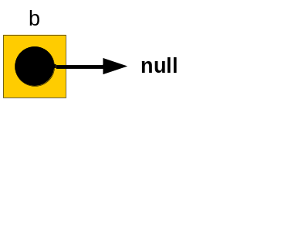
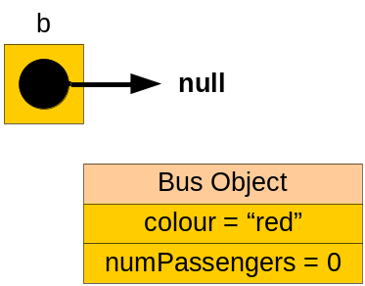
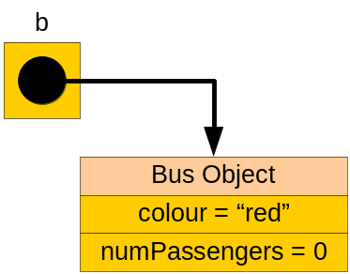
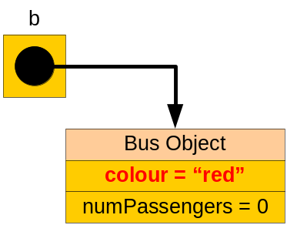
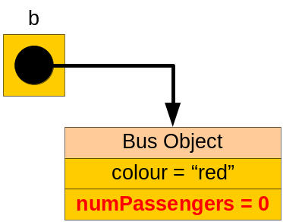
Instantiating a Bus object
class Chap6ObjectCreation {
public static void main(String argv[]) {
Bus b = new Bus();
System.out.println("Colour of bus is " +
b.colour);
System.out.println("There are " +
b.numPassengers + " passengers");
}
}
class Chap6ObjectCreation {
public static void main(String argv[]) {
Bus b = new Bus();
System.out.println("Colour of bus is " +
b.colour);
System.out.println("There are " +
b.numPassengers + " passengers");
}
}
class Chap6ObjectCreation {
public static void main(String argv[]) {
Bus b = new Bus();
System.out.println("Colour of bus is " +
b.colour);
System.out.println("There are " +
b.numPassengers + " passengers");
}
}
class Chap6ObjectCreation {
public static void main(String argv[]) {
Bus b = new Bus();
System.out.println("Colour of bus is " +
b.colour);
System.out.println("There are " +
b.numPassengers + " passengers");
}
}
class Chap6ObjectCreation {
public static void main(String argv[]) {
Bus b = new Bus();
System.out.println("Colour of bus is " +
b.colour);
System.out.println("There are " +
b.numPassengers + " passengers");
}
}
class Chap6ObjectCreation {
public static void main(String argv[]) {
Bus b = new Bus();
System.out.println("Colour of bus is " +
b.colour);
System.out.println("There are " +
b.numPassengers + " passengers");
}
}
class Chap6ObjectCreation {
public static void main(String argv[]) {
Bus b = new Bus();
System.out.println("Colour of bus is " +
b.colour);
System.out.println("There are " +
b.numPassengers + " passengers");
}
}
The new keyword creates an object of class Bus. It calls the constructor to allocate memory for representing the newly created object. Reference to the object is assigned to the variable b.
The dot is used to refer to an attribute or method of an object. In this case, the colour and numPassengers attributes of the object b were referenced.
Learn To Program Java

Slide 28

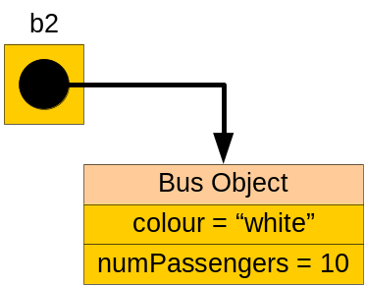
Multiple Constructor Definition
Java allows for multiple constructor definition.
Which of these constructors is used depends on what is called at the user class.
Bus b = new Bus();
Bus b1 = new Bus(“blue”);
Bus b2 = new Bus(“white",
10);
class Bus {
String colour;
int numPassengers = 0;
Bus() {
colour = “red”;
}
Bus(String c) {
colour = c;
}
Bus(String colour, int numPassengers) {
this.colour = colour;
this.numPassengers = numPassengers;
}
}
Learn To Program Java

Slide 29
Constructor Invocation
The three constructors in the previous code simply assign values
to the attributes of an object. We can also get a constructor to invoke another constructor to assign values to the
attributes.
This is done using the keyword this which refers to the current referenced object.
class Bus {
String colour;
int numPassengers = 0;
Bus() {
this(“red”);
}
Bus(String c) {
this(c, 0);
}
Bus(String colour, int numPassengers) {
this.colour = colour;
this.numPassengers = numPassengers;
}
}
class Bus {
String colour;
int numPassengers = 0;
Bus() {
this(“red”);
}
Bus(String c) {
this(c, 0);
}
Bus(String colour, int numPassengers) {
this.colour = colour;
this.numPassengers = numPassengers;
}
}
class Bus {
String colour;
int numPassengers = 0;
Bus() {
this(“red”);
}
Bus(String c) {
this(c, 0);
}
Bus(String colour, int numPassengers) {
this.colour = colour;
this.numPassengers = numPassengers;
}
}
class Bus {
String colour;
int numPassengers = 0;
Bus() {
this(“red”);
}
Bus(String c) {
this(c, 0);
}
Bus(String colour, int numPassengers) {
this.colour = colour;
this.numPassengers = numPassengers;
}
}
class Bus {
String colour;
int numPassengers = 0;
Bus() {
this(“red”);
}
Bus(String c) {
this(c, 0);
}
Bus(String colour, int numPassengers) {
this.colour = colour;
this.numPassengers = numPassengers;
}
}
class Bus {
String colour;
int numPassengers = 0;
Bus() {
this(“red”);
}
Bus(String c) {
this(c, 0);
}
Bus(String colour, int numPassengers) {
this.colour = colour;
this.numPassengers = numPassengers;
}
}
class Bus {
String colour;
int numPassengers = 0;
Bus() {
this(“red”);
}
Bus(String c) {
this(c, 0);
}
Bus(String colour, int numPassengers) {
this.colour = colour;
this.numPassengers = numPassengers;
}
}
class Bus {
String colour;
int numPassengers = 0;
Bus() {
this(“red”);
}
Bus(String c) {
this(c, 0);
}
Bus(String colour, int numPassengers) {
this.colour = colour;
this.numPassengers = numPassengers;
}
}
class Bus {
String colour;
int numPassengers = 0;
Bus() {
this(“red”);
}
Bus(String c) {
this(c, 0);
}
Bus(String colour, int numPassengers) {
this.colour = colour;
this.numPassengers = numPassengers;
}
}
When the statement Bus b = new Bus(); is called, the default constructor is executed which in turn invokes Bus(“Red”). The latter in turn invokes Bus(“Red”, 0) . This creates a red bus with zero passengers.
Learn To Program Java

Slide 30
Instance and Class Variables
The variables colour and numPassengers of a Bus object are known as instance variables or non-static variables.
Each occurrence of instance variable belongs to one and only one object.
Alternatively, we have class variables or static variables. A common variable that is shared by all the objects of the same class.
There are two ways of referencing class variables:
  Using the class name.
  Using the object’s variable name.
Learn To Program Java

Slide 31
Instance and Class Methods
Recall that a method can be a procedure or a function.
Methods that belong to objects are known as instance methods or non-static methods. Such methods allow us to change the instance variables or class variables.
Class methods or static methods allow us to change only the class variables of an object.
There are two ways of referencing class methods:
  Using the class name.
  Using the object’s variable name.
Learn To Program Java

Slide 32
Bus Example
class Bus {
String colour;
int numPassengers = 0;
static int numBuses;
Bus(String colour, int numPassengers) {
this.colour = colour;
this.numPassengers = numPassengers;
}
void board(int n) {
numPassengers += n;
}
void disembark(int n) {
numPassengers -= n;
}
static void incNumBuses() {
numBuses++;
}
}
Instance variables
Class variable
Constructor
Instance methods
Class method
Learn To Program Java

Slide 33
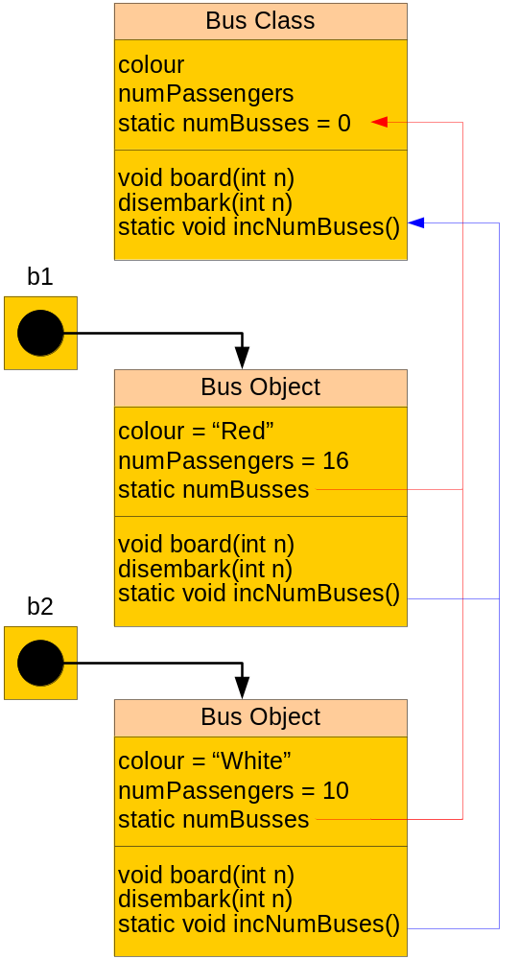
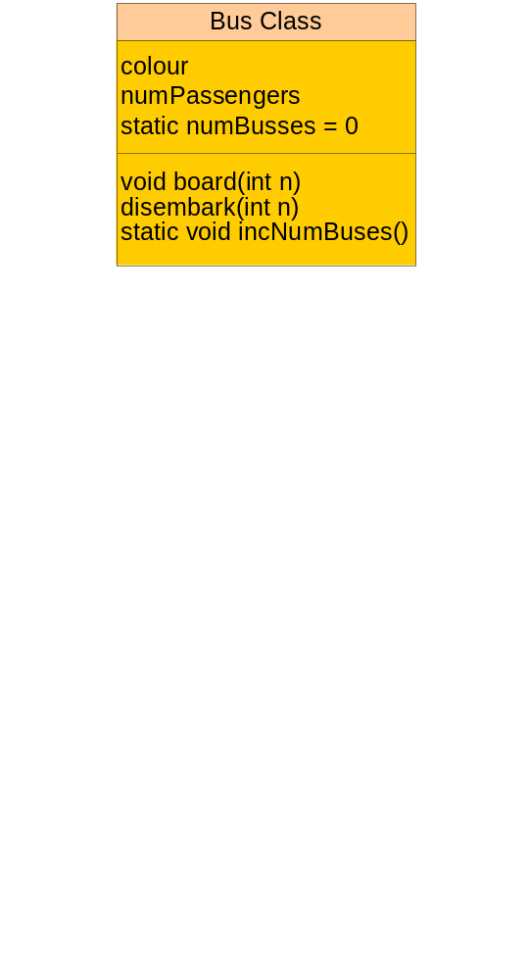
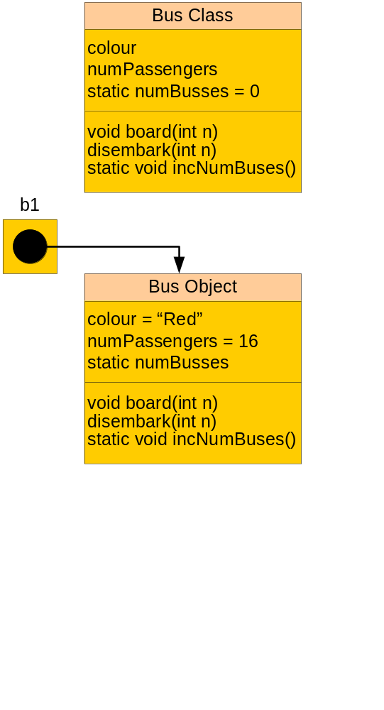
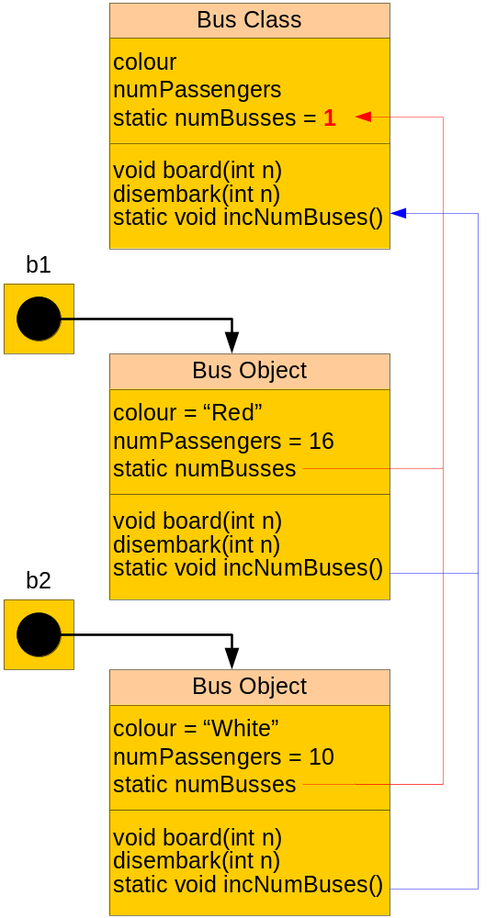





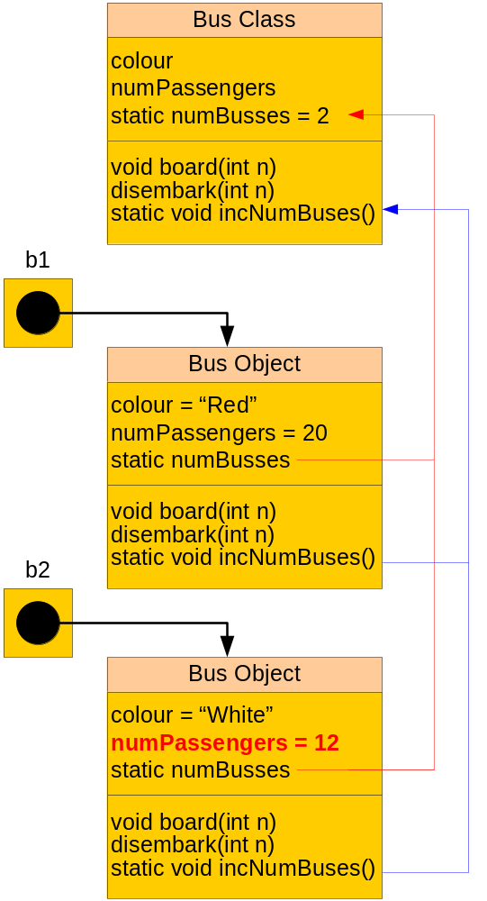
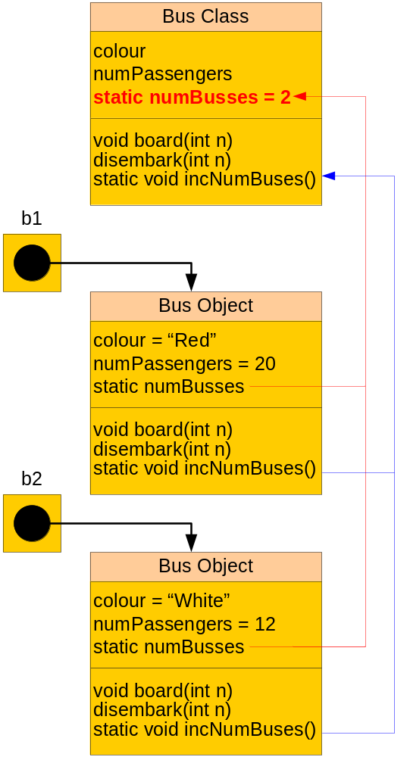
Bus Example
class Chap6StaticVarMethods {
public static void main(String argv[]) {
Bus b1 = new Bus("Red", 16);
Bus b2 = new Bus("White", 10);
b1.incNumBuses();
b2.incNumBuses();
b1.board(5);
b2.board(2);
b1.disembark(1);
System.out.println(b1.numPassengers);
System.out.println(b2.numPassengers);
System.out.println(b1.numBuses);
System.out.println(b2.numBuses);
System.out.println(Bus.numBuses);
}
}
class Chap6StaticVarMethods {
public static void main(String argv[]) {
Bus b1 = new Bus("Red", 16);
Bus b2 = new Bus("White", 10);
b1.incNumBuses();
b2.incNumBuses();
b1.board(5);
b2.board(2);
b1.disembark(1);
System.out.println(b1.numPassengers);
System.out.println(b2.numPassengers);
System.out.println(b1.numBuses);
System.out.println(b2.numBuses);
System.out.println(Bus.numBuses);
}
}
class Chap6StaticVarMethods {
public static void main(String argv[]) {
Bus b1 = new Bus("Red", 16);
Bus b2 = new Bus("White", 10);
b1.incNumBuses();
b2.incNumBuses();
b1.board(5);
b2.board(2);
b1.disembark(1);
System.out.println(b1.numPassengers);
System.out.println(b2.numPassengers);
System.out.println(b1.numBuses);
System.out.println(b2.numBuses);
System.out.println(Bus.numBuses);
}
}
class Chap6StaticVarMethods {
public static void main(String argv[]) {
Bus b1 = new Bus("Red", 16);
Bus b2 = new Bus("White", 10);
b1.incNumBuses();
b2.incNumBuses();
b1.board(5);
b2.board(2);
b1.disembark(1);
System.out.println(b1.numPassengers);
System.out.println(b2.numPassengers);
System.out.println(b1.numBuses);
System.out.println(b2.numBuses);
System.out.println(Bus.numBuses);
}
}
class Chap6StaticVarMethods {
public static void main(String argv[]) {
Bus b1 = new Bus("Red", 16);
Bus b2 = new Bus("White", 10);
b1.incNumBuses();
b2.incNumBuses();
b1.board(5);
b2.board(2);
b1.disembark(1);
System.out.println(b1.numPassengers);
System.out.println(b2.numPassengers);
System.out.println(b1.numBuses);
System.out.println(b2.numBuses);
System.out.println(Bus.numBuses);
}
}
class Chap6StaticVarMethods {
public static void main(String argv[]) {
Bus b1 = new Bus("Red", 16);
Bus b2 = new Bus("White", 10);
b1.incNumBuses();
b2.incNumBuses();
b1.board(5);
b2.board(2);
b1.disembark(1);
System.out.println(b1.numPassengers);
System.out.println(b2.numPassengers);
System.out.println(b1.numBuses);
System.out.println(b2.numBuses);
System.out.println(Bus.numBuses);
}
}
class Chap6StaticVarMethods {
public static void main(String argv[]) {
Bus b1 = new Bus("Red", 16);
Bus b2 = new Bus("White", 10);
b1.incNumBuses();
b2.incNumBuses();
b1.board(5);
b2.board(2);
b1.disembark(1);
System.out.println(b1.numPassengers);
System.out.println(b2.numPassengers);
System.out.println(b1.numBuses);
System.out.println(b2.numBuses);
System.out.println(Bus.numBuses);
}
}
class Chap6StaticVarMethods {
public static void main(String argv[]) {
Bus b1 = new Bus("Red", 16);
Bus b2 = new Bus("White", 10);
b1.incNumBuses();
b2.incNumBuses();
b1.board(5);
b2.board(2);
b1.disembark(1);
System.out.println(b1.numPassengers);
System.out.println(b2.numPassengers);
System.out.println(b1.numBuses);
System.out.println(b2.numBuses);
System.out.println(Bus.numBuses);
}
}
class Chap6StaticVarMethods {
public static void main(String argv[]) {
Bus b1 = new Bus("Red", 16);
Bus b2 = new Bus("White", 10);
b1.incNumBuses();
b2.incNumBuses();
b1.board(5);
b2.board(2);
b1.disembark(1);
System.out.println(b1.numPassengers);
System.out.println(b2.numPassengers);
System.out.println(b1.numBuses);
System.out.println(b2.numBuses);
System.out.println(Bus.numBuses);
}
}
class Chap6StaticVarMethods {
public static void main(String argv[]) {
Bus b1 = new Bus("Red", 16);
Bus b2 = new Bus("White", 10);
b1.incNumBuses();
b2.incNumBuses();
b1.board(5);
b2.board(2);
b1.disembark(1);
System.out.println(b1.numPassengers);
System.out.println(b2.numPassengers);
System.out.println(b1.numBuses);
System.out.println(b2.numBuses);
System.out.println(Bus.numBuses);
}
}
class Chap6StaticVarMethods {
public static void main(String argv[]) {
Bus b1 = new Bus("Red", 16);
Bus b2 = new Bus("White", 10);
b1.incNumBuses();
b2.incNumBuses();
b1.board(5);
b2.board(2);
b1.disembark(1);
System.out.println(b1.numPassengers);
System.out.println(b2.numPassengers);
System.out.println(b1.numBuses);
System.out.println(b2.numBuses);
System.out.println(Bus.numBuses);
}
}
class Chap6StaticVarMethods {
public static void main(String argv[]) {
Bus b1 = new Bus("Red", 16);
Bus b2 = new Bus("White", 10);
b1.incNumBuses();
b2.incNumBuses();
b1.board(5);
b2.board(2);
b1.disembark(1);
System.out.println(b1.numPassengers);
System.out.println(b2.numPassengers);
System.out.println(b1.numBuses);
System.out.println(b2.numBuses);
System.out.println(Bus.numBuses);
}
}
class Chap6StaticVarMethods {
public static void main(String argv[]) {
Bus b1 = new Bus("Red", 16);
Bus b2 = new Bus("White", 10);
b1.incNumBuses();
b2.incNumBuses();
b1.board(5);
b2.board(2);
b1.disembark(1);
System.out.println(b1.numPassengers);
System.out.println(b2.numPassengers);
System.out.println(b1.numBuses);
System.out.println(b2.numBuses);
System.out.println(Bus.numBuses);
}
}
class Chap6StaticVarMethods {
public static void main(String argv[]) {
Bus b1 = new Bus("Red", 16);
Bus b2 = new Bus("White", 10);
b1.incNumBuses();
b2.incNumBuses();
b1.board(5);
b2.board(2);
b1.disembark(1);
System.out.println(b1.numPassengers);
System.out.println(b2.numPassengers);
System.out.println(b1.numBuses);
System.out.println(b2.numBuses);
System.out.println(Bus.numBuses);
}
}
Learn To Program Java

Slide 34
Class Hierarchy
In Object-Oriented Programming, classes are related to one another hierarchically.
For example, the class Bus we introduced earlier can also be considered as a Vehicle. Similarly, if we have a class Car, this class can also be considered as a Vehicle too.
Vehicle
Superclass
Subclasses
Bus
Car
Truck
Motorcycle
Learn To Program Java

Slide 35
Superclass and Subclass
A more general class (such as Vehicle) is known as a superclass of a class that is more specific (e.g. Bus).
A superclass, being more general, has properties that are common to classes that are more specific.
The more specific classes are known as subclasses.
Subclasses, being more specific, would have some properties that are not common to the other classes in the hierarchy. The uncommon properties distinguish a subclass from the other subclasses.
The hierarchical relationship of superclasses and subclasses are represented in Java using the extends keyword.
Learn To Program Java

Slide 36
Superclass and Subclass (cont)
class Vehicle {
Vehicle() {}
}
class Truck extends Vehicle {
String colour;
int numPassengers = 0;
Truck(String colour,
int numPassengers) {
this.colour = colour;
this.numPassengers =
numPassengers;
}
}
class Bus extends Vehicle {
String colour;
int numPassengers = 0;
Bus(String colour,
int numPassengers) {
this.colour = colour;
this.numPassengers =
numPassengers;
}
}
The properties colour and numPassengers are common in all subclasses. The number of passengers permissible for truck may be restricted to 1. That restriction is typically handled as a constraint check.
Learn To Program Java

Slide 37
Inheritance
Instead of repeating the definition of common properties in subclasses, Java allows for the common properties to be defined in the superclass once and implicitly propagate their definition to the lower subclasses.
class Vehicle {
String colour;
int numPassengers = 0;
Vehicle() {}
}
class Truck extends Vehicle {
Truck(String colour,
int numPassengers) {
this.colour = colour;
this.numPassengers =
numPassengers;
}
}
class Bus extends Vehicle {
Bus(String colour,
int numPassengers) {
this.colour = colour;
this.numPassengers =
numPassengers;
}
}
Learn To Program Java

Slide 38
Summary
Data Abstraction - A technique for grouping data and operations together to form a concept. Details of operations are hidden and are not visible to the users.
Object and Class - Classes define objects in that Classes are templates that define the static structure and dynamic behaviour of all objects the classes are associated with.
Components of objects and classes - These components include instance variables and methods for objects and class variables and methods for classes.
Class hierarchy - Classes are related to one another hierarchically. The more general classes are known as superclasses of the more specific classes (also known as subclasses). Subclasses contain specific properties that distinguish them from other classes in the hierarchy.
Inheritance. The mechanism for propagating the definition of common properties in superclass to the subclasses. In Java, inheritance is achieved via the extends keyword.
Learn To Program Java

